Slide 1
Water Flow
Water is pumped to the tops of skyscrapers,
between fields and cities, and everywhere in between.
Moving water efficiently is an important area of
research in engineering.

Slide 2
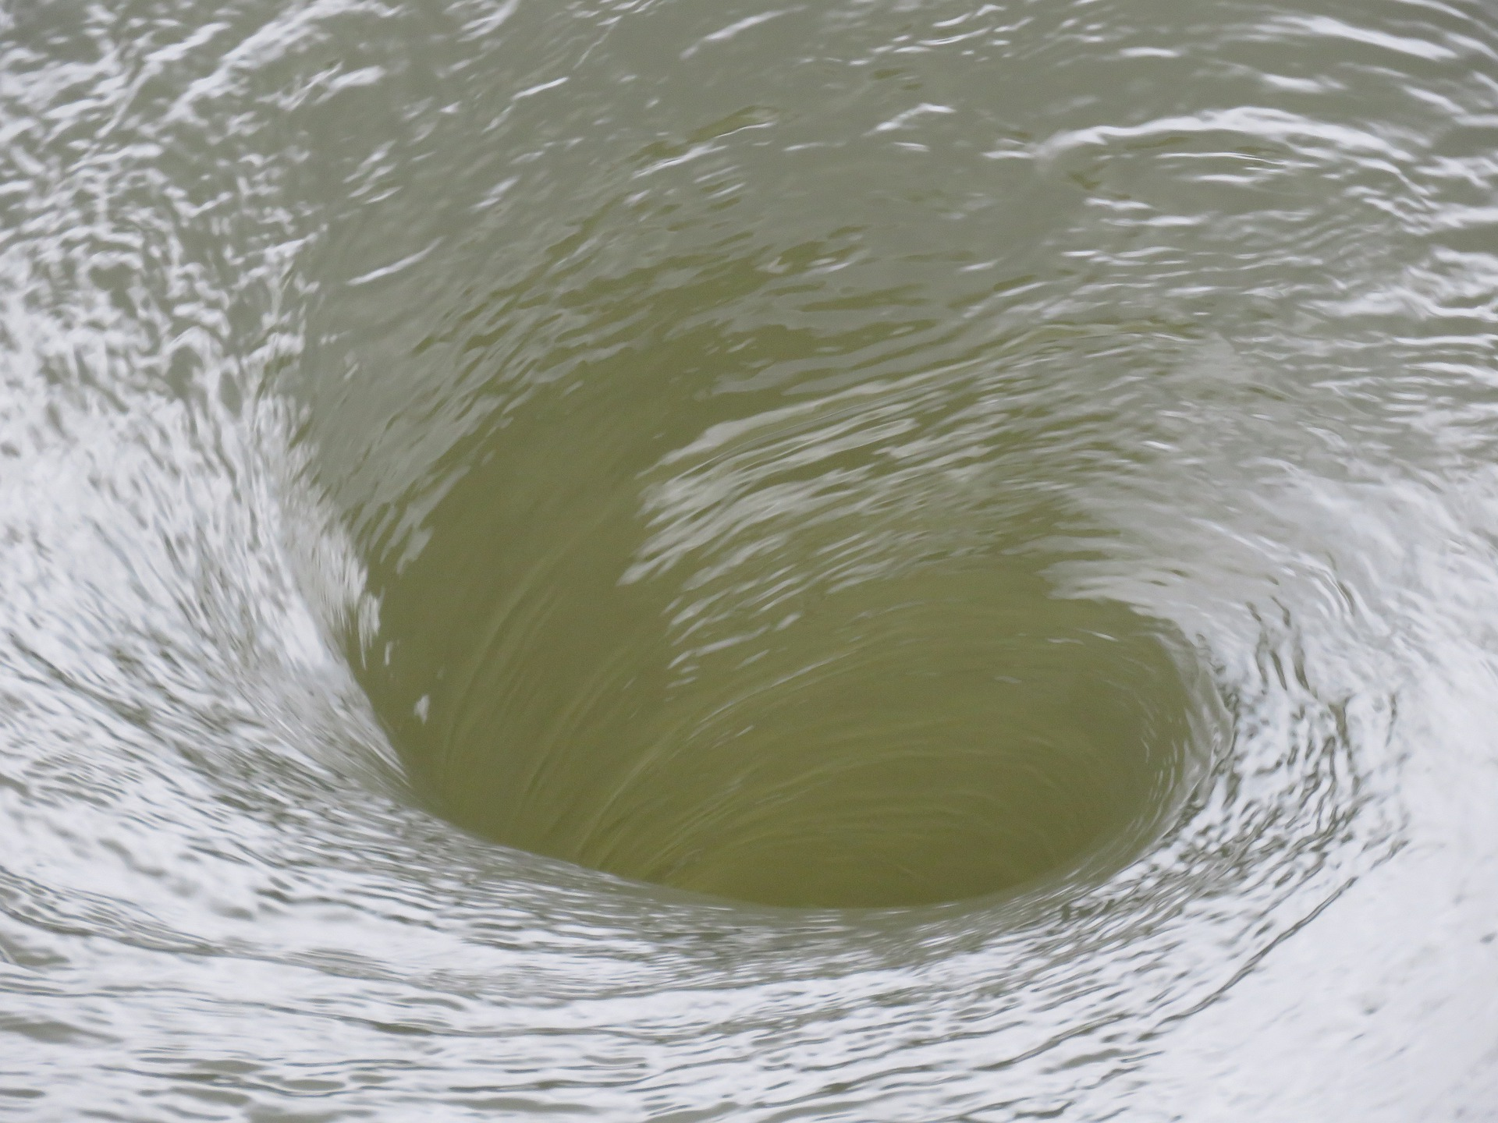
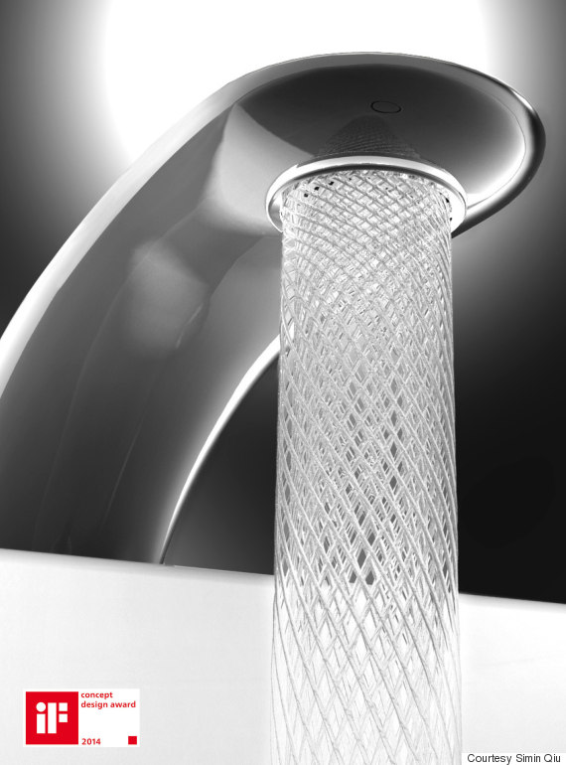
Water Flow Hints
MANY inventions have been inspired by the vortex created from water flow. Here is one example of a faucet that conserves water using a vortex.
Think about the relationship between form and function.
Other water flow ideas:
Roots/trees − capillary action, xylem
Water cycle
Currents
Image by orca13p from Pixabay

Slide 3
Adhesion
From your tennis shoes to your desk at school, adhesives or glues are a major part of our world. Finding non-toxic and high-performance solutions would have wide value in human technologies.

Slide 4
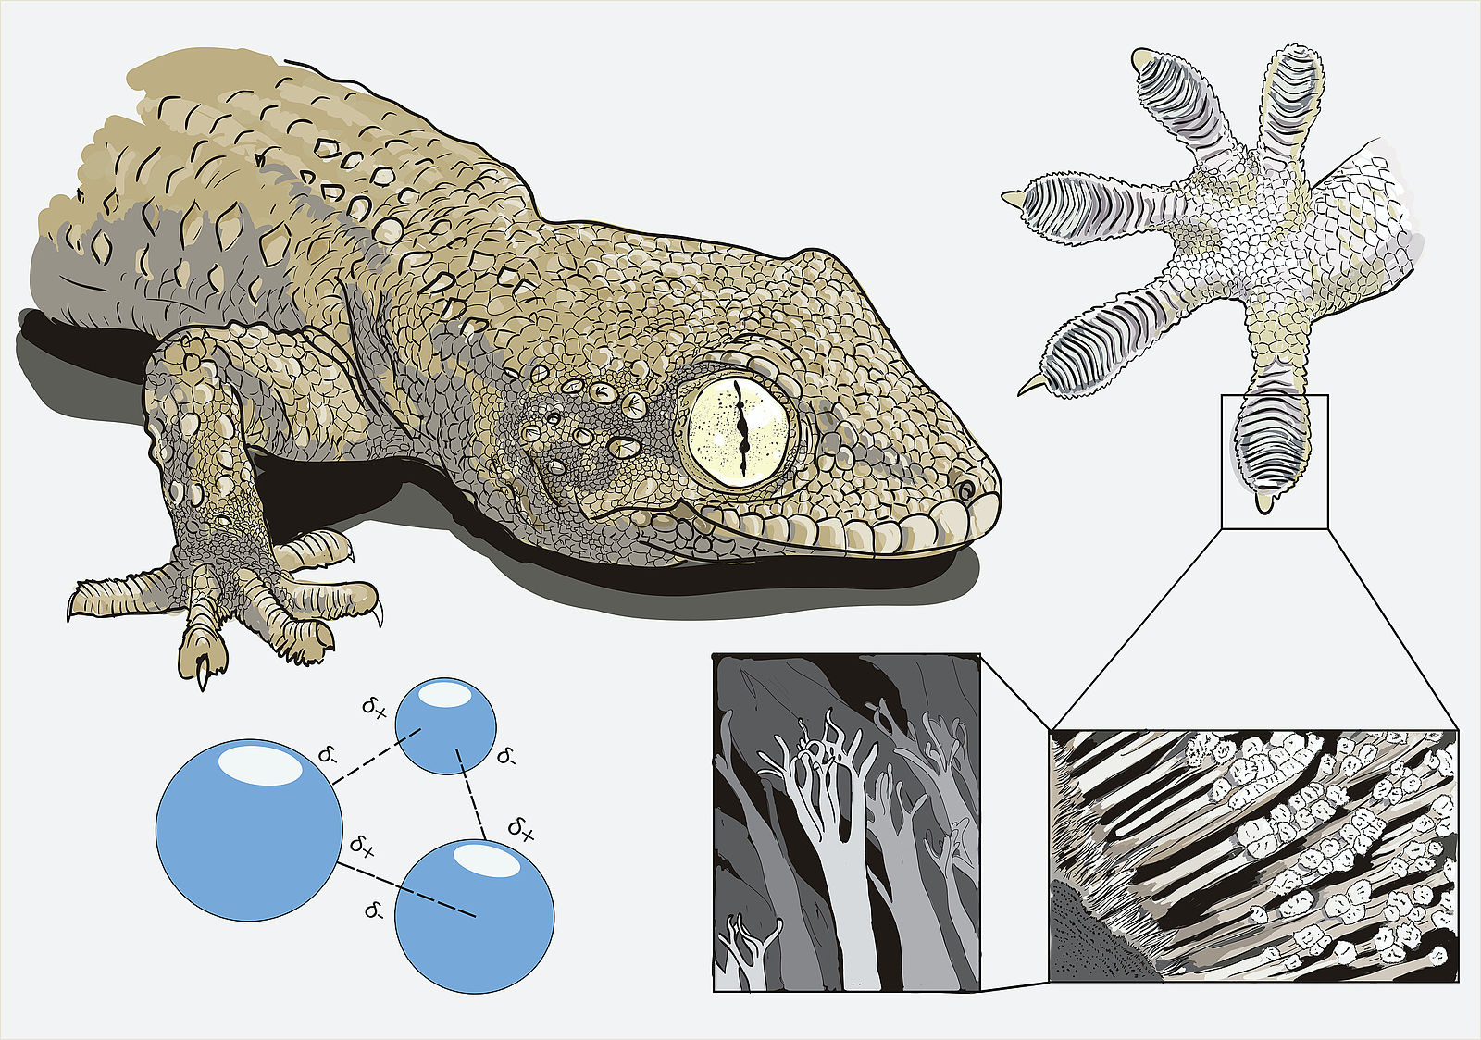
Adhesion Hints
Geckos have inspired design in many ways, including Geckskin created by researchers at the University of Massachusetts Amherst.
What features allow geckos to stick to surfaces to climb so well?
Other adhesion ideas:
Barnacle
Snail foot
Byssal threads with mussels
Squid Suckers
Coral attachments
https://commons.wikimedia.org/wiki/File:Gecko%27s_secret_power_-_Matteo_Gabaglio.jpg

Slide 5
Filter
Lots of organisms filter, and human
technologies (e.g., air ducts) require
effective filtering as well.

Slide 6
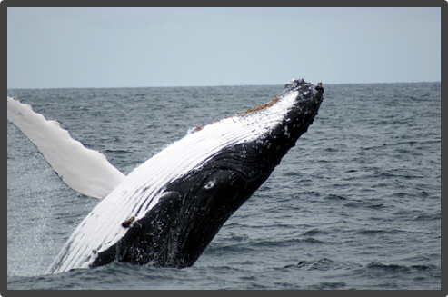
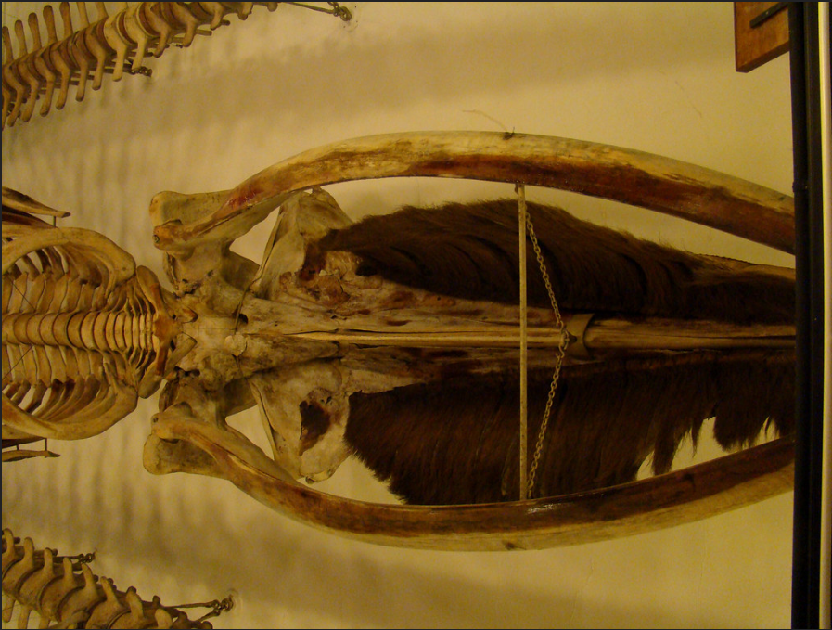
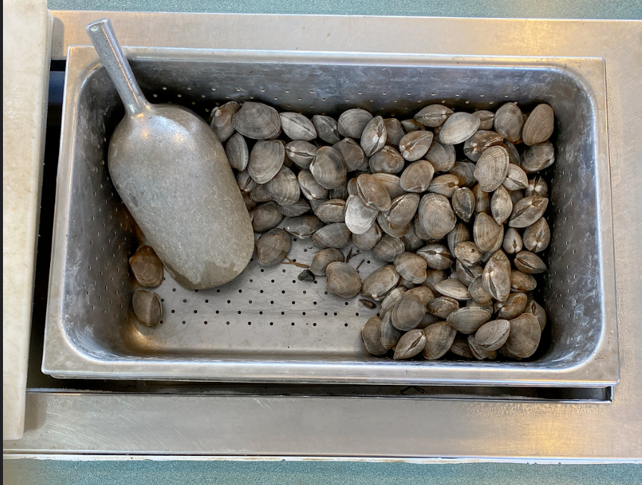
Filter Hints
There are many organisms that filter water to eat. They remove unwanted objects and only keep what is helpful or important.
Others filter ideas:
Countercurrent exchange system in circulatory/respiratory systems
Peat − salt marshes
Filter feeders (baleen whales, planktivorous sharks, gill rakers)
Gills/lungs
Plants
Notes:
Butter clams - https://www.flickr.com/photos/adavey/49878247461/in/photolist-2iZz4eP-2jzXbcE-PVnnCB-sQmFX1-oi14Wu-2j5R3UL-CYF3Pk-2eGY8CY-LSK2q8-cz5pnb-5UaBZX-2gaXoPR-eVA2kA-CL2rSA-eVoBNX-XJSu57-XWpnWA-2iPqXGj-URhdfb-o7i1gA-22UWSRT-iSB2sZ-bdnhxg-2hAj17P-YfXH8f-TS85g6-2hAj1YD-2jiZ6nG-UU2CqB-2jiUUuP-2eAjvUX-2hAfetY-2hAj1EN-etZFAv-2iMw45y-eASFpx-cz5p9A-6vsE5W-2hpEzTo-Xev4mE-2iPtGtR-2hAfeMo-2hAi5oF-ck8Wvm-2hAj1mg-2iPNdLo-2hJXAmi-URhbm1-2izRMzZ-2hHbY1X
Whale - https://www.flickr.com/photos/istolethetv/2510708358/in/photolist-cWkVEG-4e2jy3-23XKfEr-dtPX5P-3b5sbX-PyLHaT-4ReTp5-LQoZkK-drMUZh-4GYRW-4PS389-28GcLhk-2gU1uRD-drMUXA-Mi6DJc-FmY83P-6d9Kbm-rCYV4Q-qGkhVB-qGimic-ieJ7D8-rD1UUY-rmw5R3-9mdQwc-bRJDy4-z3N7Qi-rD5s6x-8Uonkn-qGhNdF-qG7VBE-rD23sx-rmCx7B-rmwaXf-2i6iwwq-rD5q7H-7G2icu-3b6iZx-MByTZ7-QJVy7j-LyKsuu-2YNx7P-a6xPbg-EfAoPa-4vkUsk-2j5vCd2-9KmJ2C-5i4Agk-pvDTnC-N9KSrd-2i6n4Pt/

Slide 7
Cleaning
Nature doesn’t use detergents
to clean. What are some other ways
nature uses?

Slide 8
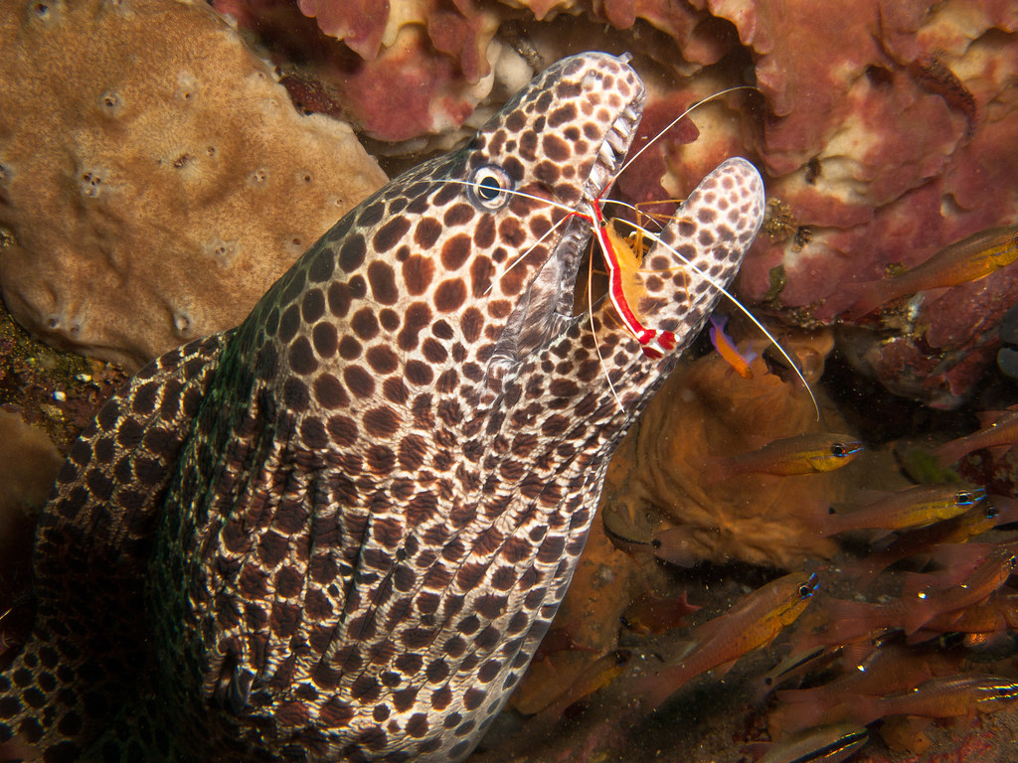
Cleaning Hints
This is a cleaner shrimp on an eel. It may look like the eel is eating the shrimp, but actually the shrimp is eating ectoparasites and dead skin for its meal, and the eel is getting cleaned.
How can organisms be used to clean our environment?
Other cleaning ideas:
Plants (lotus, kale)
Birds − preening
Cleaning stations in marine environments
7597017388_06f0b81243_b.jpg
Notes:
Lotus: https://moshiel.com/post/10164009296

Slide 9
Waste Removal
In nature, there really is no such thing as waste.
In contrast, humans produce about 96% waste for
every 4% product. Could we learn a better way to
make what we need?

Slide 10
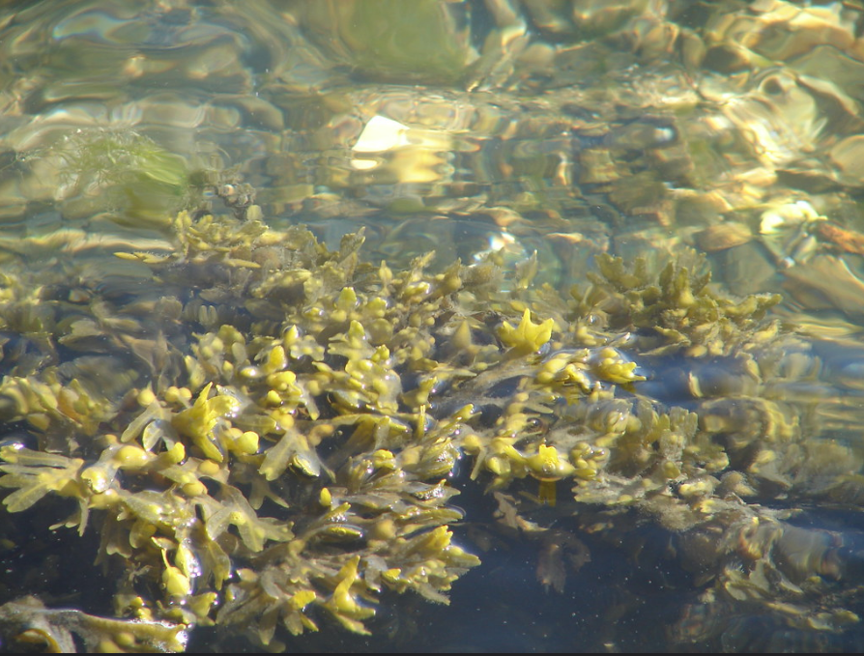
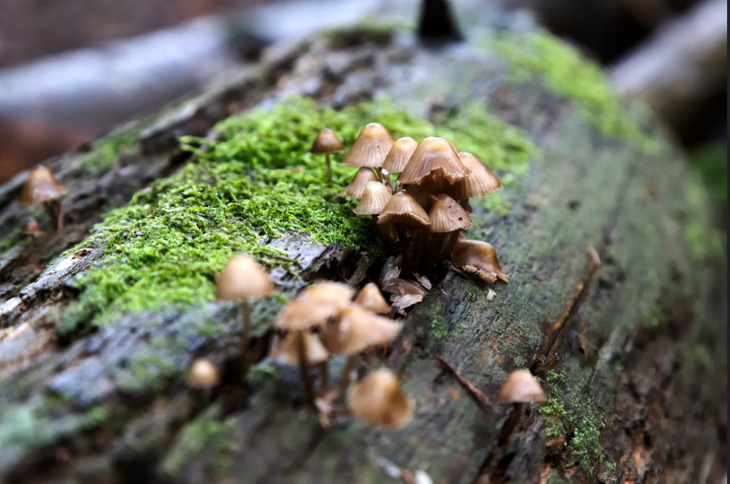
Waste Removal Hints
Other waste removal ideas:
Algae (nutrients from waste)
Plants/trees (carbon usage)
Scavengers/detritivores
Insects
Mushrooms
Notes:
Algae - flickr.com/photos/quinnanya/622105334/in/photolist-WYsf3-6PcnWX-pwHZi-dVoFmM-5nSAkk-bWscRS-bdc88t-2jj8a7Q-hfaU3-6h5ocb-4AQx2h-5THA6h-ex1At-PFCW9M-bVv7ML-pNmiU8-848KbT-EcxB2-5fzkCh-bVwf6y-CBR9Z7-PaamCd-puoya-hmAAW-bVvh1w-HnL7ct-Gyf7RE-oSwWvh-Gyf7ph-4BP9N-nrzbMB-3bQ997-p8Q5hJ-6v64TZ-8F9CmH-8cfMiP-pxDXK-R3KmqF-549B6d-PC6q8h-PC6s5y-oLW9B-NUCUHY-PC6o5u-5raHH-4Ww7tQ-ziVYxj-ejYBpw-a1VM4W-dNuXxJ
Myshrooms - https://www.flickr.com/photos/strocchi/30823618715/in/photolist-NXM6XZ-2cZpHqg-YvbhwC-RXdhfz-dMEGpC-p2cWkz-9ZqTgS-49EsB9-djk4Sz-b7Dxtn-djATwi-3ujPT-djASWa-zmGkXJ-ZDe3qE-aT3VDP-zoBqd4-8KKwCi-AijWKR-8U8aFM-2eXXc-djATLv-pw9KtQ-Uh4jkj-djAR1E-djATci-djARbj-djAShc-djASRv-pZ9pc-yPBzJm-ZDe7vJ-YFdAxJ-qmcQJ-6H14fA-pcpryF-djASwy-djARoG-5nfvju-djASqY-djARTP-djARto-6CSNGm-djARCf-djATAX-djARfA-djAThR-7Lxo7w-25ANhf-pFBz3Y

Slide 11
Carbon Storage
Removing and storing carbon is, of course, a critical
issue given climate change. Models in the natural world have been managing carbon for millions of years.

Slide 12
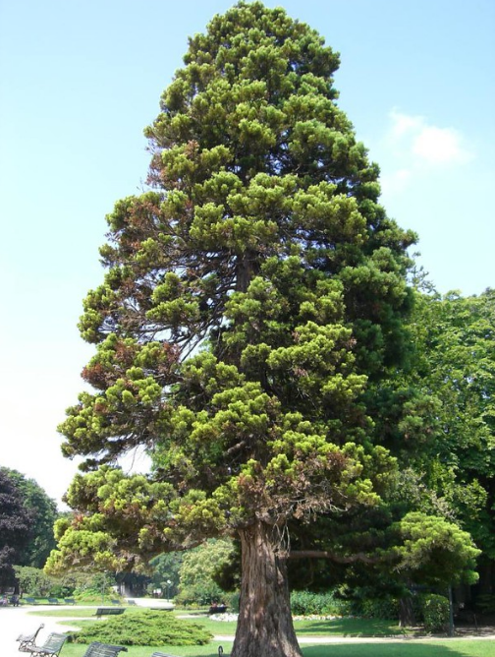
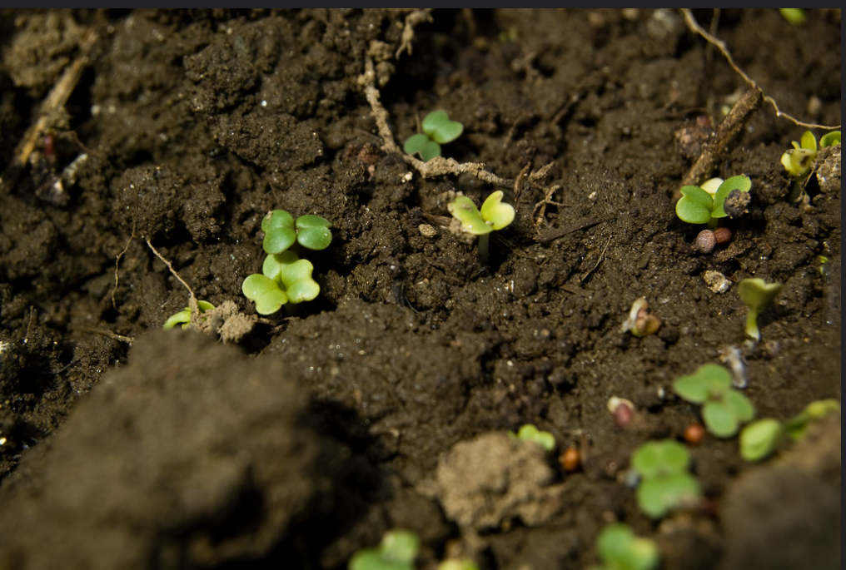
Carbon Storage Hints
Other ideas for carbon storage:
Soil
Tree/plants (video)
Notes:
Soil . https://www.flickr.com/photos/bert_m_b/2399011853/in/photolist-86RPQm-oZABWp-4DZyDk-qikrge-mZQg6s-29Ahg79-ZPyZ6y-21Tc87P-ntpzaz-cFyJKu-24hBqWw-rVKqDp-23vuRat-24joiMM-2cJjJBt-2dGnkP1-LcMGAP-TK65fL-Dypwqy-6bT1Mm-KJk3ZK-7yHcV2-4fs9RX-ZVZc3z-KdkmKY-2dZaLpr-4DZyha-bp4HB-2aFkDN8-eGemkQ-22dSdYx-MQYgVW-Jkak8E-27gXhZw-2cCg7nL-25THRE9-PNUcrY-GKHpZR-2aXWWET-29wnLhn-2djdipx-21er7PA-2e7gWgB-25YnGb2-27E94qL-23DdQgZ-ZUr4np-RXN9gx-ZE8UWu-21rcGmG/
Tree - https://www.flickr.com/photos/-epsilon-/8838398871/in/photolist-et274r-8Jtz9Q-EnptXp-yEM1WJ-NnDQck-bUurhS-ngsKyR-d8udC9-7ZddkJ-pQBxFF-or8n2j-e1PGbW-7Uahs1-9scJhV-4Rqoyk-rwhx6n-6V4Evf-5v6DBH-Aq9dkd-67p1kK-69THJB-5vsbCi-bVnUAS-eMYSib-95k1iy-Cbbow6-32atNs-b2x1Fz-n5Fr4b-9ArRA2-7Q1dVo-5tANF6-9dWjd8-7T27xW-H8Zrmm-Fe63ZG-bmAz1-qLj55Z-5DC811-siartr-21FsLfY-cGHLy5-ET5KpR-5nwc5b-PLwCMj-TmjkZs-hUtP5d-hU7rUY-v7KBR-8ayiD4

Slide 13
Communication
Information plays a major role in human technologies,
from cell phones to computer systems.
What could nature teach us?

Slide 14
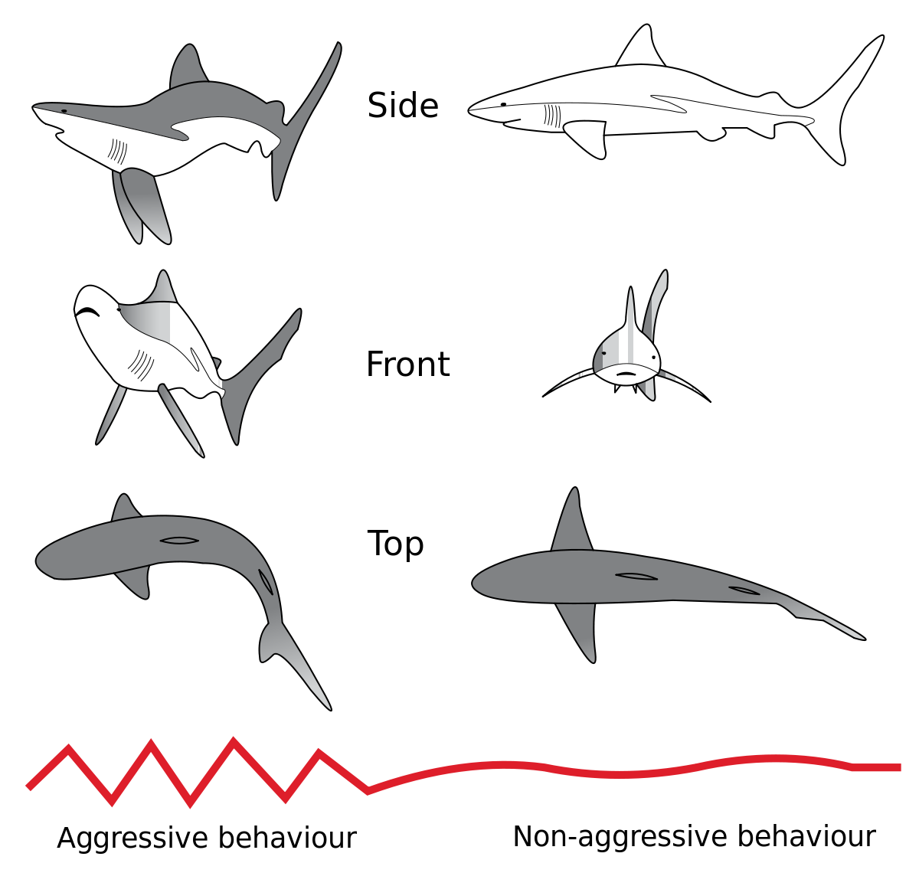
Communication Hints
Look at the picture to the left.
How is the shark changing or modifying its features (form)?
What is the purpose of this change (function)?
What are other ways that organisms communicate?
Other communication ideas:
Tree roots in a forest
Animal sounds
Color
Behavior
https://commons.wikimedia.org/wiki/File:Shark_threat_display.svg

Slide 15
Movement/Transport
Nature has many different methods for movement.
What ways can you think of? Can we learn more
environmentally friendly ways to move from nature?

Slide 16
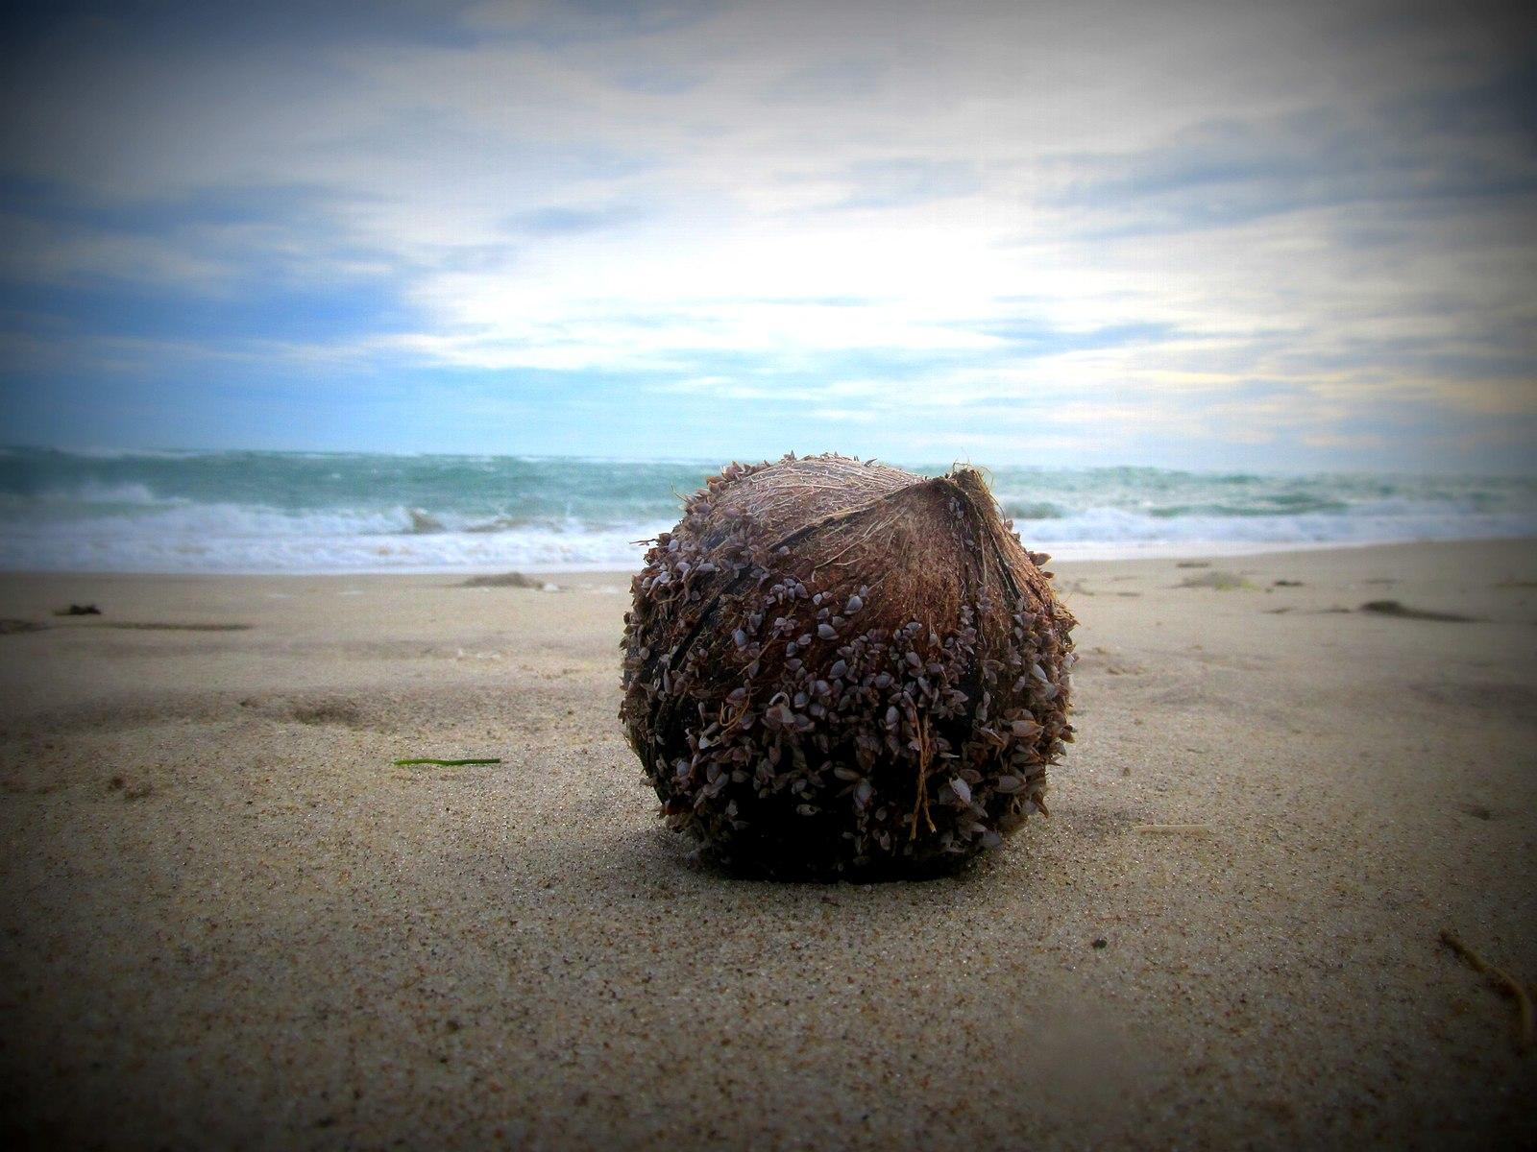
Movement/Transport Hints
Coconuts are hollow and can float. Why would these be important features? Can you think of any design or inventions that mimic this?
Other ideas for movement/transport:
Seeds
Body parts
Water cycle
Weather Patterns
Spirals − hurricanes, growth of shells, water drainage
https://commons.wikimedia.org/wiki/File:Sea_shells_on_top_of_a_coconut.jpg

Slide 17
Recycling
Recycling is an important and sometimes complex
function. What are some of the ways nature has
to solve this necessary function?

Slide 18
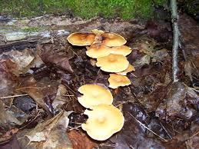
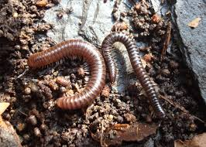
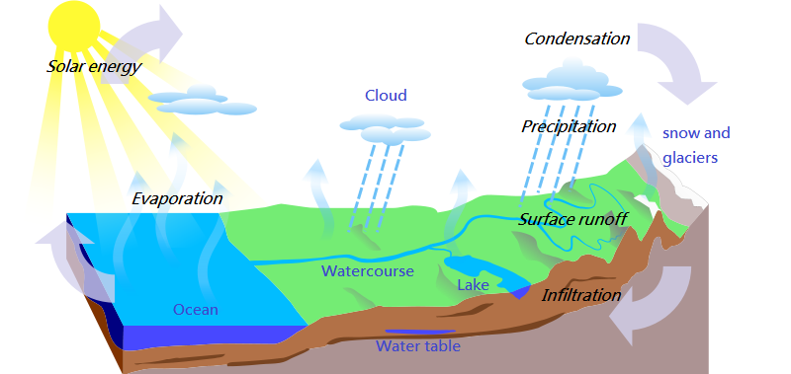
Recycling Hints
Other recycling ideas:
Water cycle
Mushrooms
Detritivores
Food chain or webs
Whole ecosystems

Slide 19
MAKE YOUR OWN 1
Add description

Slide 20
Add your own visuals
and scaffolding 1

Slide 21
MAKE YOUR OWN 2
Add description

Slide 22
Add your own visuals
and scaffolding 2

Slide 23
MAKE YOUR OWN 3
Add description

Slide 24
Add your own visuals
and scaffolding 3

